Slide 1
Context-Aware Market Basket Analysis (C-MBA)

Slide 2
TEAM MEMBERS
Samudrala Venkata Maruthi (vsamudra@uab.edu)
Sajja Venkata Syam Naga Pavan (Vsajja@uab.edu)
Karnatakapu Vijay Deepak (vkarnata@uab.edu)
Sujith Madhusudhana (madhusus@uab.edu)
Bollineni Nishanth (nbolline@uab.edu).
PROFESSOR
-DR. ZHANG CHENGCUI

Slide 3
Introduction
Customers’ buying behaviour plays a crucial role when it comes to the competition in the retail sector as well as the use of various marketing techniques and storage of inventory.
Market Basket Analysis or MBA is a highly useful method that describes associations between products that are purchased together by consumers and may give detailed information about a consumer’s behaviour.
Market Basket Analysis makes transactions transparent to help retailers develop promotions, arrange products optimally, and seek strategies for increasing sales as well as customers’ satisfaction.
We have used the well-known DM Apriori algorithm that is used to identify association rules between items.

Slide 4
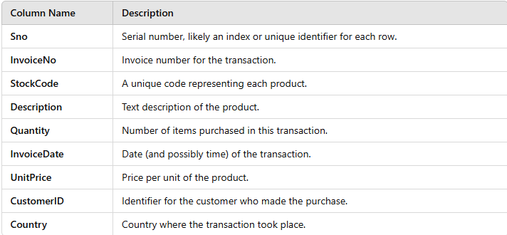
Data Collection and Preparation
Data Collection
The dataset consists of transactional records representing items purchased in individual transactions.
Each row corresponds to a unique transaction, detailing the purchased items.
The dataset is cleaned to ensure that only meaningful and valid records were retained for analysis.
Transactions with null values, missing information, or anomalies were excluded.

Slide 5
Data Pre-Processing
Data preprocessing involved multiple steps to prepare the transactional data for mining and predictive modelling:
Data Cleaning:
The dataset was cleared of null values, missing entries and duplicate rows as a means of improving its quality.
On top of that, the baskets were arranged whereby a basket was a single transaction (Singh et al. 2020).
Data Transformation:
Data labels are continuing, so in order to make transactions more understandable, they were converted to a binary matrix into by using the one hot technique.
This approach transformed each transaction a vector of 0 and 1 where each item in the basket was reflected by a 1 if present in the transaction basket and 0 if not.

Slide 6
Implementation of Apriori Algorithm
The Apriori algorithm is used for the identification of a frequent itemset as well as for the generation of association rules.
The following parameters were set:
Minimum support: 0.01 to take into account only those itemset which are occurred in 1% transactions or more.
Minimum confidence: 0.2, choosing rules that have at least 20% predictive strength.
Minimum lift: 1.0, this made rules highly predictive rather than being based on chance.

Slide 7
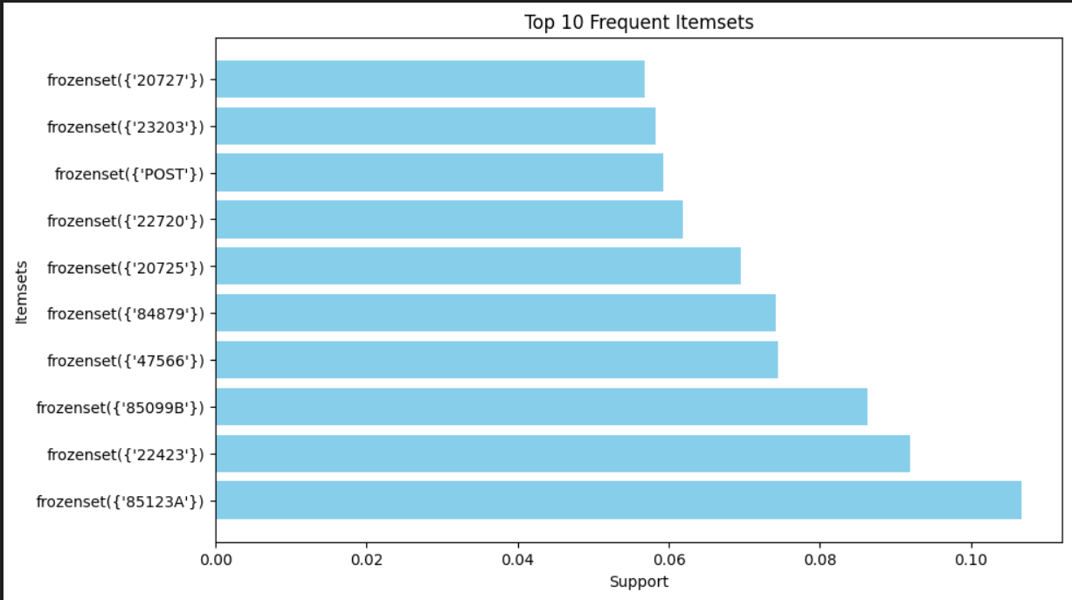
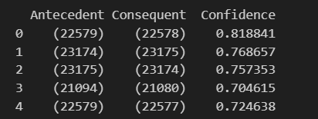
Figure 1: Frequent itemset
Figure 2: Rules for confidence

Slide 8
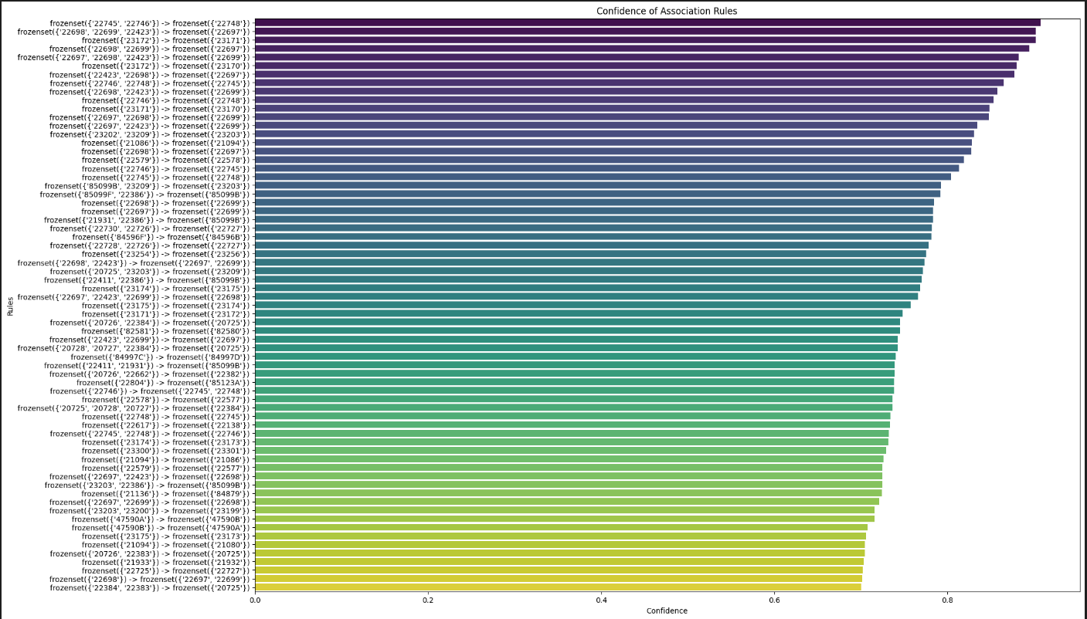
Model Implementation
To enhance the utility of association rule mining, predictive modelling was employed using two classification algorithms as described below:
A binary classification analysis will include logistic regression and the decision tree classifier techniques.
These models sought to estimate the probability of the association rules to be of high confidence, where confidence refers to rules with a score of greater than 0.8.
The data set contained association rules paired with their
confidence and support levels, and a target variable which was
either high or low confidence.
Figure 3: Confidence of association rules

Slide 9
Logistic Regression Model
The Logistic Regression model achieved an overall accuracy of 78.57%, suggesting a fair ability to differentiate between high- and low-confidence rules.
The confusion matrix revealed the following:
True Positives (TP): 11
False Positives (FP): 0
False Negatives (FN): 3
True Negatives (TN): 0
While the model performed well in predicting high-confidence rules, it struggled to correctly identify low-confidence ones, as indicated by the absence of true negatives and the presence of false negatives.

Slide 10
Decision Tree Model
The Decision Tree Classifier demonstrated superior performance, achieving a perfect accuracy of 100%.
Its confusion matrix is as follows:
True Positives (TP): 11
False Positives (FP): 0
False Negatives (FN): 0
True Negatives (TN): 3
Unlike Logistic Regression, the Decision Tree correctly classified all instances, making no misclassifications.

Slide 11
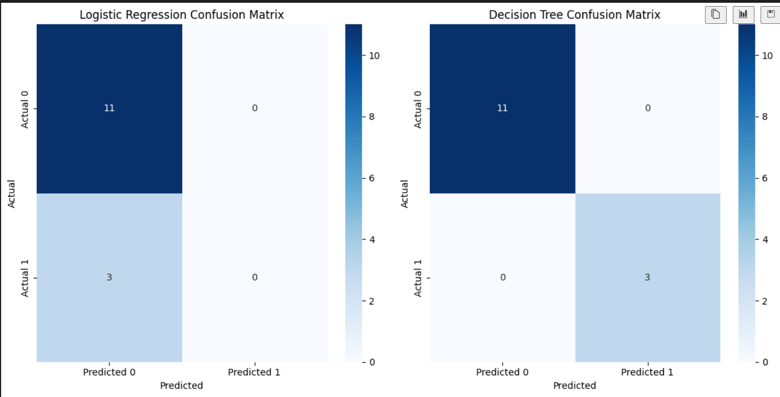
Analysis
The performance of both models is visualized using confusion matrices:
Logistic Regression Confusion Matrix: Highlighted accurate predictions for high-confidence rules but notable misclassification of low-confidence ones (false negatives).
Decision Tree Confusion Matrix: Demonstrated flawless performance with no misclassifications.
Figure 4: Confusion matrix

Slide 12
Interpretation
The significant difference in the results of the two models on the dataset used shows that it is necessary to choose a suitable algorithm given the characteristics of the input data.
Although Logistic Regression offers simplicity and interpretability in the model, its restriction on non-linear relationship makes it less suitable for this purpose.
On the other hand, the Decision Tree Classifier was more flexible and versatile in its application and the results yielded by it were ideal as compared to the former.

Slide 13
Discussion
Key Findings
The analysis revealed critical insights into item associations and the efficacy of prediction models:
Apriori Algorithm Performance: Analysing the results of the Apriori algorithm, many important item associations were given, like {milk, bread} →{butter} with good confidence and lift.
These associations identify prospective buying behaviours which may prove helpful with regard to retail decisions.
Machine Learning Classification Models: The Logistic Regression was trained with an accuracy of 78.57 % whereas the Decision Tree model tested with an accuracy of 100% on the test set.
From the confusion matrix, it was evident that the Decision Tree did not misclassify any of the data making it superior in producing high confidence association rules.

Slide 14
Retailer Insights
The findings have several practical implications for retail operations:
Inventory Optimization: The common item pairs help a retailer to restock products and avoid situations where customers demand products that are not available or are stacked with products they rarely buy.
For instance, if {milk, bread} associates with {butter}, it will help the retailers to keep these items together to facilitate purchases.
Personalized Marketing: High lift value association rules can also be used in creating marketing initiatives, for example, joint sales promotions or promotions.
These efforts can boost customer satisfaction and trigger further sales, as experience has shown. For example, promoting {bread, jam} as a set can win the loyalty of consumers and boost sales (Poli et al. 2023).

Slide 15
Limitation And Future Work
Limitation
Despite the valuable insights, the study had limitations that warrant consideration:
Dataset Size and Scope: The analysis was conducted on a relatively small and static dataset. This limits the generalizability and scalability of the findings to larger, dynamic datasets often encountered in real-world retail settings.
Future Work
The potential for further enhancing the current approach to market basket analysis (MBA) is vast. Below are several avenues for future work:

Slide 16
Real time Market Analysis
Another prospective direction is applying real-time data streaming approaches that can support on-the-fly rule generation and evaluation.
In the constantly changing today’s environment, virtual MBA, instant at Apache Kafka or Spark Streaming, can be applied to emerging ones to respond simultaneously to the customer’s behaviour.
For example, real-time analysis can be used to recommend related products during the e-shopping processes to make consumers’ experiences more relevant (Zamil et al. 2020).
Advanced Techniques
To push the boundaries of traditional MBA, advanced methodologies can be explored:
Deep Learning Models: The neural network, and in particular, the recurrent and convolutional neural networks, can reveal more complex, non-linear dependencies between items.
These models could incorporate temporal properties, thus providing more dynamism that corresponds with the changing customer behaviour at different time stamps (Ghous et al. 2023).

Slide 17
Broader Applications
Market Basket analysis has its usefulness in retail, it is not limited to this aspect of business.
In E-commerce, it can help to enhance recommendations based on the user’s preferences, clicks, or purchase history.
Likewise, in medicine, MBA can search for patterns like diseases that often accompany each other or medications that should not be used concurrently.
Thus, MBA used in connection with apply of these techniques in the various spheres permitted to eliminate shortcomings observed in a decision-making process and to increase the efficiency of operation.

Slide 18
References
Singh, S.K. and Dwivedi, D.R.K., 2020. Data mining: dirty data and data cleaning. Available at SSRN 3610772.
Poli, N.S. and Sikder, A.S., 2023. Predictive Analysis of Sales Using the Apriori Algorithm: A Comprehensive Study on Sales Forecasting and Business Strategies in the Retail Industry.: Predictive Analysis of Sales Using the Apriori Algorithm. International Journal of Imminent Science & Technology, 1(1), pp.1-16.
Zamil, A.M.A., Al Adwan, A. and Vasista, T.G., 2020. Enhancing customer loyalty with market basket analysis using innovative methods: a python implementation approach. International Journal of Innovation, Creativity and Change, 14(2), pp.1351-1368.
Ghous, H., Malik, M. and Rehman, I., 2023. Deep Learning based Market Basket Analysis using Association Rules. KIET Journal of Computing and Information Sciences, 6(2), pp.14-34.

Slide 19
THANK YOU

